Slide 1


INNOVATING EXCELLENCE
The New Standard in Precision Technology
Introducing the NEXUS Series: Engineering the future of global industry with Japanese precision and visionary design.

Slide 2


Legacy of Innovation
A Foundation of Trust
Established in 1968 in Osaka, Japan, we have dedicated over five decades to the pursuit of "Monozukuri" — the art of making things with absolute perfection.
55+ Years Experience
32 Global Patents

Slide 3






Market Challenges
Inefficiency
Rigid Systems
Reliability Gaps
Current industrial solutions struggle with high energy consumption and frequent maintenance downtime.
Legacy hardware lacks the integration capabilities required for modern IoT-driven environments.
Standard components often fail under extreme stress, leading to significant financial losses.

Slide 4

The NEXUS Solution
Our flagship series represents a paradigm shift in performance engineering. Designed for seamless integration and extreme durability.
99.9% Operational Reliability
Advanced AI-Driven Diagnostics
Eco-Certifed Energy Efficiency

Slide 5



Strategic Capabilities
Ultra-Speed
Green Tech
Cyber-Secure
Next-gen processing cores allow for real-time adjustments at micro-millisecond intervals.
Reduces carbon footprint by up to 35% through intelligent load-balancing algorithms.
Military-grade encryption ensures your operational data remains private and protected.

Slide 6
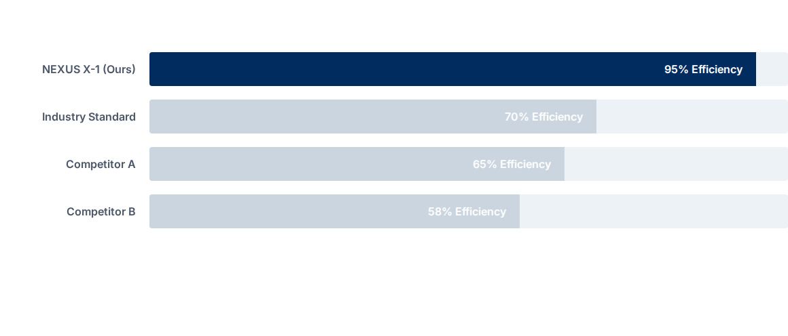
Performance Advantage
Tested under standard ISO 9001 conditions. Efficiency measured by output vs energy input ratio.

Slide 7


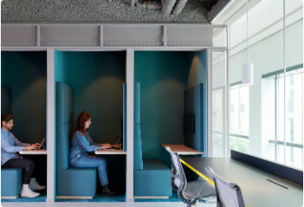


Versatile Applications
Manufacturing
Smart Offices
Advanced R&D

Slide 8
Precision Specifications
Parameter | Standard Model | Enterprise Pro
Dimensions | 240 x 180 x 45 mm | 310 x 220 x 60 mm
Chassis Material | Aero-Grade Aluminum | Titanium Composite
Operating Temp | -10°C to 45°C | -30°C to 75°C
Network Connectivity | 5G / Wi-Fi 6 | 5G / Satellite / Fiber
Weight | 1.2 kg | 1.8 kg

Slide 9

Commitment to Quality
ISO 9001 & 14001: Global certification for quality and environmental management systems.
100% Inspection: Every unit undergoes a 48-hour stress test before shipment.
5-Year Warranty: Industry-leading support and parts replacement guarantee.
Global Service: 24/7 technical support hubs in London, New York, and Tokyo.
Certified Japanese Craftsmanship

Slide 10

PARTNERSHIP FOR GROWTH
Let's Engineer the Future Together
Ready to elevate your operations? Contact our international business development team for a tailored consultation.
Contact Us
Email: global-sales@nexus.jp
Phone: +81-6-6000-XXXX
Web: www.nexus-tech.jp/en
Scan to download catalog
Thank you for your attention.

