Slide 1





SKETCHNOTES LESSON
Here is where your presentation begins
Presented by: Mr. Oliver Harrison

Slide 2






SCIENCE LAB STUDY
Curious Minds, Experiments, and Discoveries
Physics & Chemistry • Module 4

Slide 3






CREATIVE ARTS LAB
Color Theory, Design Principles, and Expression
Course Portfolio • Volume 2

Slide 4




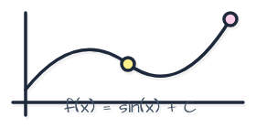

MATH & STUDY GUIDE
Formulas, Geometry, and Logical Problem Solving
Unit 2: Advanced Algebra Foundations

Slide 5





ADVENTURE LEARNING
Global Exploration, Geography, & Discoveries
Social Studies & Earth Sciences • Grade 7

