Slide 1


CREATIVE STUDIO ASIA
CONFIDENTIAL // INTERNAL
REF // JB-2026
PROJECT BRIEF DECK
An architectural visual strategy constructed around structured whitespace and executive content layout.
TOKYO OFFICE // MAY 2026
Add a subtitle or company tagline here
Presented By Design Research Unit
Presented To Strategic Committee
Phase 01 // Initial Briefing

Slide 2


MUSEUM ARCHIVES // SERIES 08
Project Code SYS-2026-A8
Date 2026.05.18
Version v1.0 Stable
ANNUAL OUTLOOK
Evaluating contemporary paradigms, creative market entries, and evolving publication guidelines.
© Studio Editorial Group. Compiled for institutional and public distribution in Tokyo & Zurich.
Prepared For Executive Council
Author Lead Curator Desk
COVER DESIGN 05 // DIAGONAL EDITORIAL SYSTEM
COVER DESIGN 04 // BOTTOM-HEAVY ARCHITECTURAL
COVER DESIGN 03 // CENTRAL STAMP LAYOUT

Slide 3

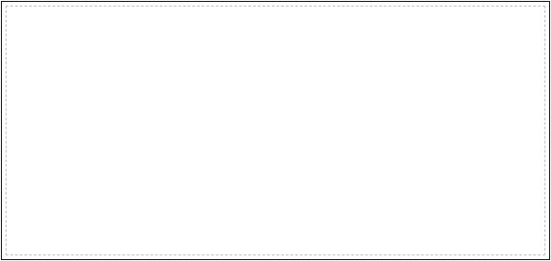

COVER DESIGN 03 // CENTRAL STAMP LAYOUT
KRONOS RESEARCH UNIT OFFICIAL STANDARD
CLASSIFICATION: RESTRICTED INDEX NO. // 90-A4
DOCUMENT REGISTER
RESEARCH REPORT
VOLUME IV // ISSUE II
FILE REFERENCE SEC-MARKETS_2026
DATE OF REVISION MAY 18, 2026

Slide 4


COVER DESIGN 04 // BOTTOM-HEAVY ARCHITECTURAL
COVER DESIGN 03 // CENTRAL STAMP LAYOUT
ARCH-PROPOSAL SYS_GRID_04
LAT: 35.6762° N // LONG: 139.6503° E
// SUBTITLE: DESIGNING SPATIAL & VIRTUAL ARCHITECTURAL EXPERIENCES
BRAND PROPOSAL & IDENTITY
PREPARED BY: Alpha Space Unit
PREPARED FOR: Studio Associates
TIMELINE: Q2 - Q4 FY2026
VALID UNTIL: JULY 2026

Slide 5


COVER DESIGN 05 // DIAGONAL EDITORIAL SYSTEM
COVER DESIGN 04 // BOTTOM-HEAVY ARCHITECTURAL
COVER DESIGN 03 // CENTRAL STAMP LAYOUT
Creative Strategy Deck SYSTEM MODEL REF-05
CREATIVE STRATEGY
A dynamic layout architecture balancing fine angled guidelines, slanted bar marks, and pristine asymmetry.
Japanese Series Title クリエイティブ戦略 // サブタイトル
Node Standard SYS_NODE_5.0
Distributed Date 05 / 18 / 2026

